Slide 1
Introduction to Design Pattern
Lutfun Nahar Lota
Lecturer, CSE

Slide 2
The Beginning of Patterns
“Each pattern describes a problem which occurs over and over again in our environment, and then describes the core of the solution to that problem, in such a way that you can use this solution a million times over, without ever doing it the same way twice.”

Slide 3
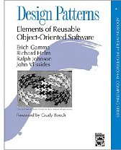
“Gang of Four” (GoF) Book
Design Patterns: Elements of Reusable Object-Oriented Software, Addison-Wesley Publishing Company, 1994
Written by this "gang of four"
Dr. Erich Gamma, then Software Engineer, Taligent, Inc.
Dr. Richard Helm, then Senior Technology Consultant, DMR Group
Dr. Ralph Johnson, then and now at University of Illinois, Computer Science Department
Dr. John Vlissides, then a researcher at IBM
Thomas J. Watson Research Center
See John's WikiWiki tribute page http://c2.com/cgi/wiki?JohnVlissides

Slide 4
Other Discovered Patterns
The book Data Access Patterns by Clifton Nock introduces 4 decoupling patterns,
5 resource patterns, 5 I/O patterns, 7 cache patterns, and 4 concurrency patterns.

Slide 5
Types of Design Patterns
Three categories of Design Pattern
Creational patterns deal with the process of object creation and class instantiation
Structural patterns, deal with structure of classes and objects to form larger structures and provide new functionality.
Behavioral patterns, which deal with dynamic interaction among classes and objects

Slide 6
GoF Patterns
Creational Patterns
Abstract Factory
Builder
Factory Method
Prototype
Singleton
Structural Patterns
Adapter
Bridge
Composite
Decorator
Façade
Flyweight
Proxy
Behavioral Patterns
Chain of Responsibility
Command
Interpreter
Iterator
Mediator
Memento
Observer
State
Strategy
Template Method
Visitor

Slide 7
Why Study Patterns?
Reusable in multiple projects.
Provide the solutions that help to define the system architecture.
Capture the software engineering experiences.
Provide transparency to the design of an application.
Well-proved and testified solutions since they have been built upon the knowledge and experience of expert software developers.
Design patterns don't guarantee an absolute solution to a problem. They provide clarity to the system architecture and the possibility of building a better system.

Slide 8
Other advantages
Most design patterns make software more modifiable, less brittle
we are using time tested solutions
Using design patterns makes software systems easier to change—more maintainable
Helps increase the understanding of basic object-oriented design principles
encapsulation, inheritance, interfaces, polymorphism

Slide 9
Style for Describing Patterns
We will use this structure:
Pattern name
Recurring problem: what problem the pattern addresses
Solution: the general approach of the pattern
UML for the pattern
Participants: a description as a class diagram
Use Example(s): examples of this pattern, in Java

Slide 10


Template Pattern
Football
initialize(){}
StartPlay() {}
endPlay(){}
Cricket
initialize(){}
StartPlay() {}
endPlay(){}

Slide 11
Template Pattern
Football
initialize(){}
StartPlay() {}
endPlay(){}
Derive the Parent Class
Game
initialize(){}
StartPlay() {}
endPlay(){}
Cricket
initialize(){}
StartPlay() {}
endPlay(){}

Slide 12
Template Pattern
Football
initialize(){}
StartPlay() {}
endPlay(){}
Make it Abstract
Game
initialize();
StartPlay() ;
endPlay();
Cricket
The method should be declared ‘final’
initialize(){}
StartPlay() {}
endPlay(){}

Slide 13

Template Pattern
Football f = new Football();
f.initialize(){}
f.StartPlay() {}
f.endPlay() {}
Cricket c = new Cricket();
c.initialize(){}
c.StartPlay() {}
c.endPlay() {}

Slide 14
Template Pattern
Football f = new Football();
Cricket c = new Cricket();
Play(){
initialize();
StartPlay();
endPlay() ;
}
initialize(){}
StartPlay(){}
endPlay() {}
Play(){
initialize();
StartPlay();
endPlay() ;
}
initialize(){}
StartPlay(){}
endPlay() {}
Football f = new Football();
f.play();
Cricket c = new Cricket();
c.play();

Slide 15
Template Pattern
Intent
Define the skeleton of an algorithm in an operation, deferring some steps to client subclasses. Template Method lets subclasses redefine certain steps of an algorithm without changing the algorithm's structure.

Slide 16
Template Pattern
Problem
Two different components have significant similarities, but demonstrate no reuse of common interface or implementation.

Slide 17
Template Pattern
Solution
The Template Method pattern suggests that you break down an algorithm into a series of steps, turn these steps into methods, and put a series of calls to these methods inside a single template method.

Slide 18
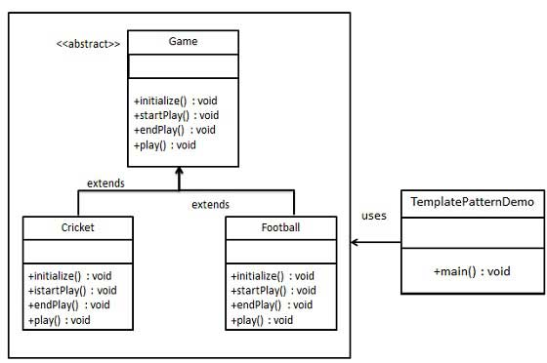
Class Diagram for Template Pattern

Slide 19
Strategy Pattern
Is a behavioural pattern
A class behavior or its algorithm can be changed at run time.
Enforces: Open Closed Principle
“Software entities (classes, modules, functions, etc.) should be open for extension, but closed for modification.”

Slide 20
Strategy Pattern
Intent
Define a family of algorithms, encapsulate each one, and make them interchangeable. Strategy lets the algorithm vary independently from the clients that use it.
Capture the abstraction in an interface, bury implementation details in derived classes.

Slide 21
Strategy Pattern
Problem
encapsulate interface details in a base class, and bury implementation details in derived classes. Clients can then couple themselves to an interface, and not have to experience the upheaval associated with change: no impact when the number of derived classes changes, and no impact when the implementation of a derived class changes.

Slide 22
Strategy Pattern Problem
Class Arithmetic Calculator{
If (add){
res = a+b;
Return res;
}
If (sub){
res = a-b;
Return res;
}
}

Slide 23
Strategy Pattern Problem
Class Arithmetic Calculator{
If (add){
res = a+b;
}
If (sub){
res = a-b;
}
If (mul){
res = a*b;
}
}

Slide 24
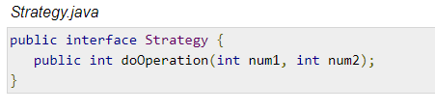
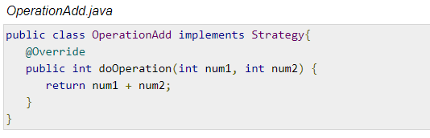
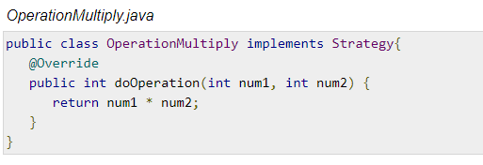
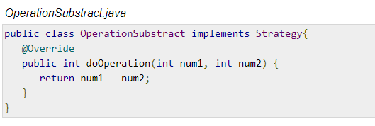
Strategy Pattern

Slide 25
Strategy Pattern
OperationAdd aaaa = new OperationAdd()
aaaa.doOperation(10,5);
OperationSub bbbb = new OperationSub()
bbbb.doOperation(10,5);

Slide 26
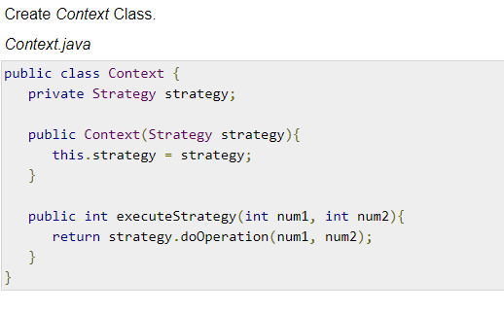
Strategy Pattern

Slide 27
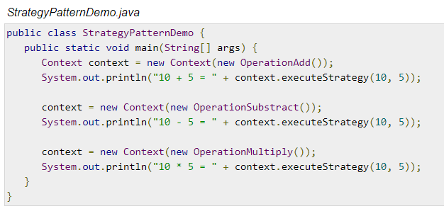
Strategy Pattern

Slide 28
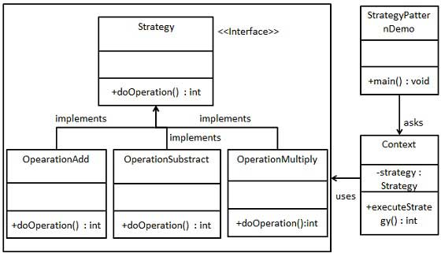
Strategy Pattern UML Diagram

